Slide 1


ML Challenge 2024
Problem Statement
To build a machine learning model that extracts key entity values from images, like weight, volume, dimensions.
TEAM NAME
WE CODE
Aastha Dubey
Chaitanya Gaur
Anmol Pal
Prachi Pandey

Slide 2
Data Preprocessing
First, we split the data into manageable chunks to optimize processing within Google Colab's time and resource limits. We then utilized concurrent processing to download images in parallel, improving the speed of data retrieval. Once images were downloaded, we applied OCR using EasyOCR to extract text from the images. Regular expressions (regex) were then used to categorize the extracted text into specific entity types, ensuring accurate matching to the required values like weight, volume, and dimensions.

Slide 3
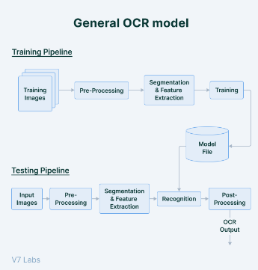
Approach
🔹 Breaking Down the Data: Instead of processing the entire dataset at once, we strategically broke it into smaller chunks of 10,000 rows.
🔹 Parallel & Concurrent Image Downloading: To deal with the scale, we implemented parallel image downloading using Python’s ThreadPoolExecutor.
🔹 Multiprocessing for Speed: We leveraged multiprocessing to concurrently process images and extract text, making the most of our system’s resources.
🔹 EasyOCR & Entity Categorization: Using EasyOCR with GPU support, we extracted text from images and categorized it based on specific entities using custom regex patterns.
This combination of batch processing, multiprocessing, parallel downloading, and efficient storage ensured we could tackle the large dataset effectively and within time constraints.

Slide 4

Thankyou

